Slide 1
Addressing Edge AI Challenges to scale
Anomaly detection/inference made simple with Eclipse Kura & Kapua

Slide 2




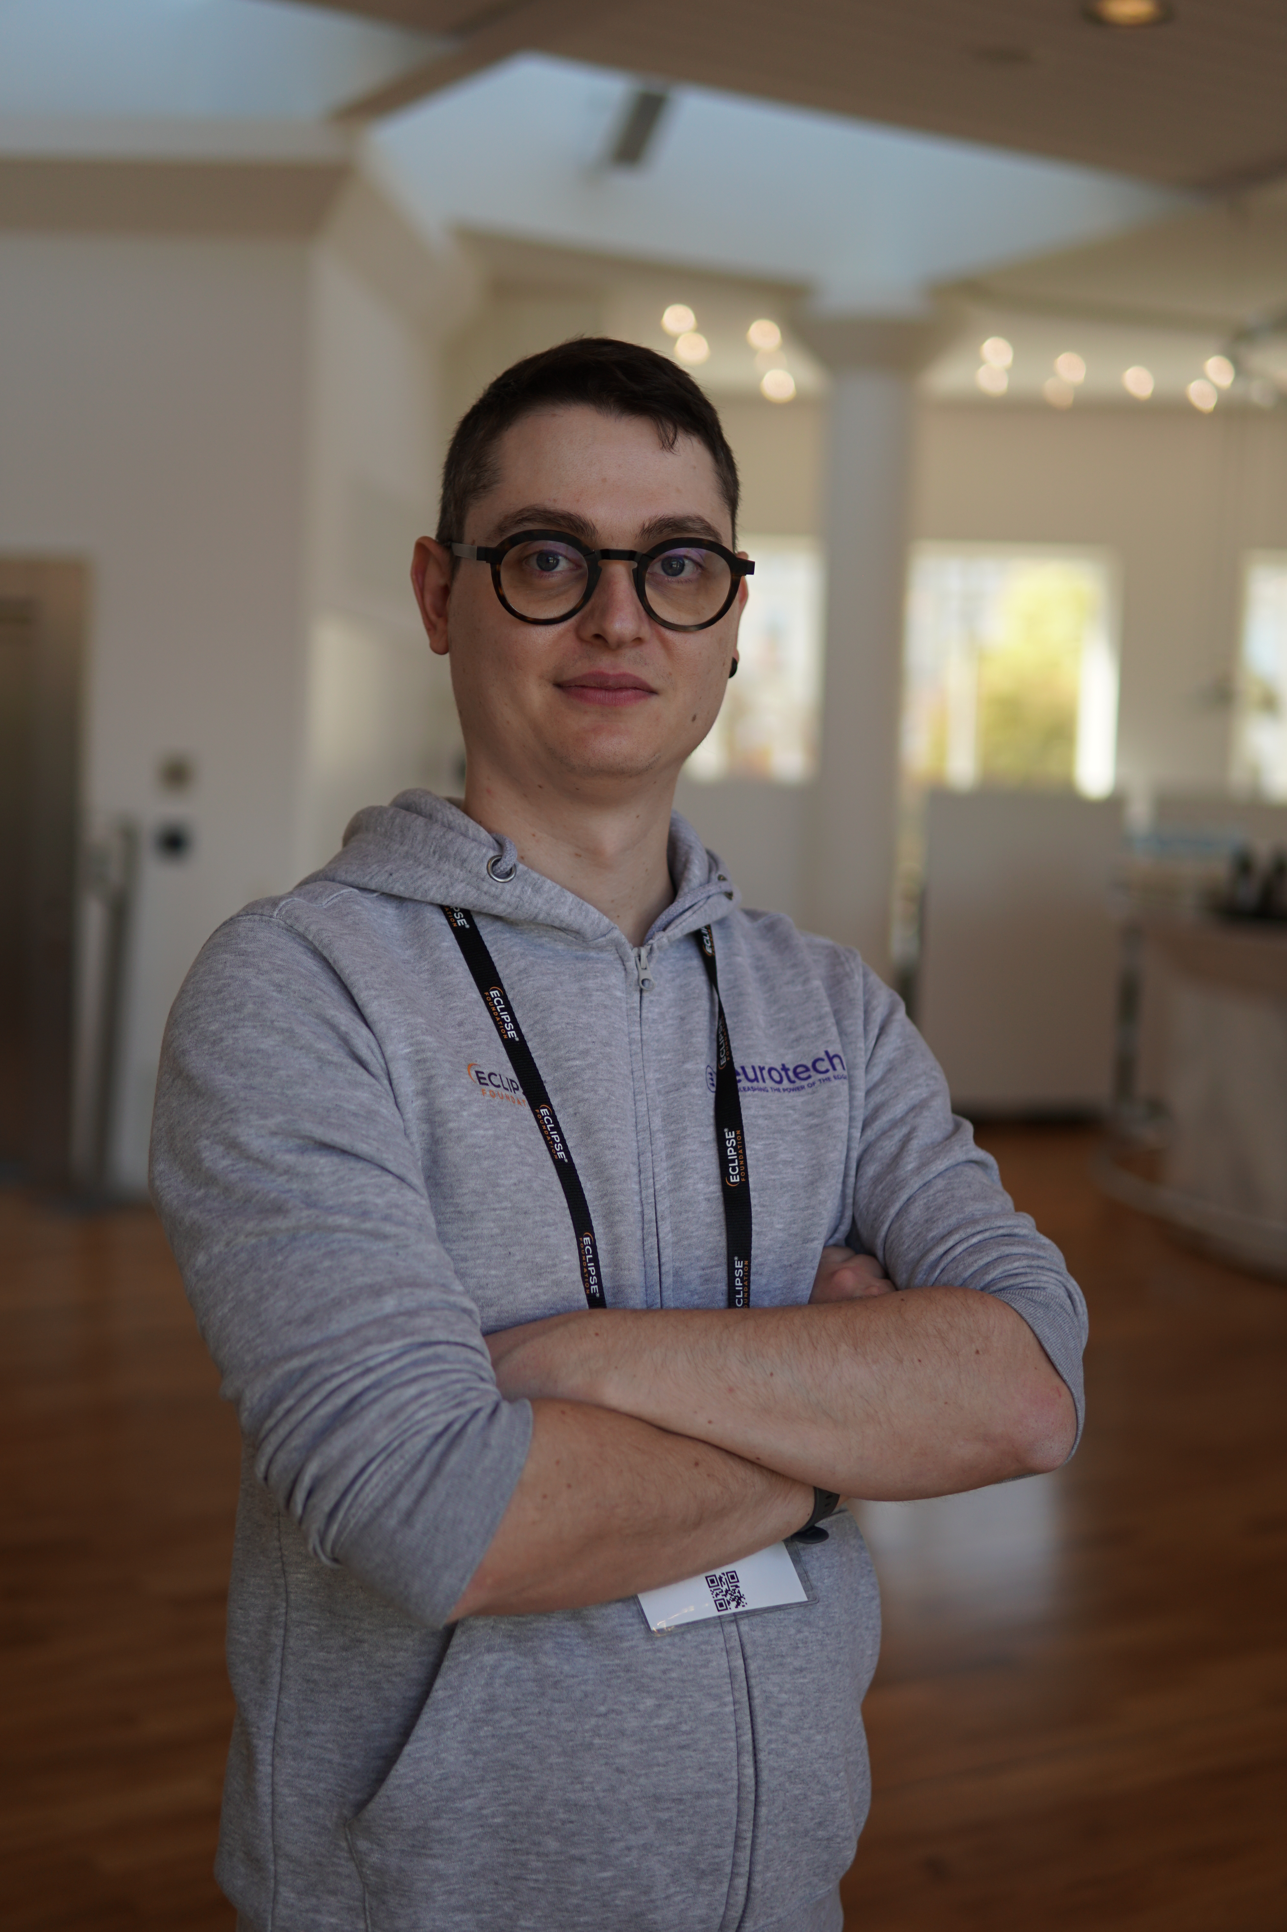

Who we are
Salvatore Coppola
Senior Engineer @ Eurotech SPA
Gregory Ivo
Engineer @ Eurotech Inc
Simone Fiorani
Engineer @ Eurotech SPA
Mattia Dal Ben
Engineer @ Eurotech Inc

Slide 3
What is a Edge Iot Deployment?

Slide 4
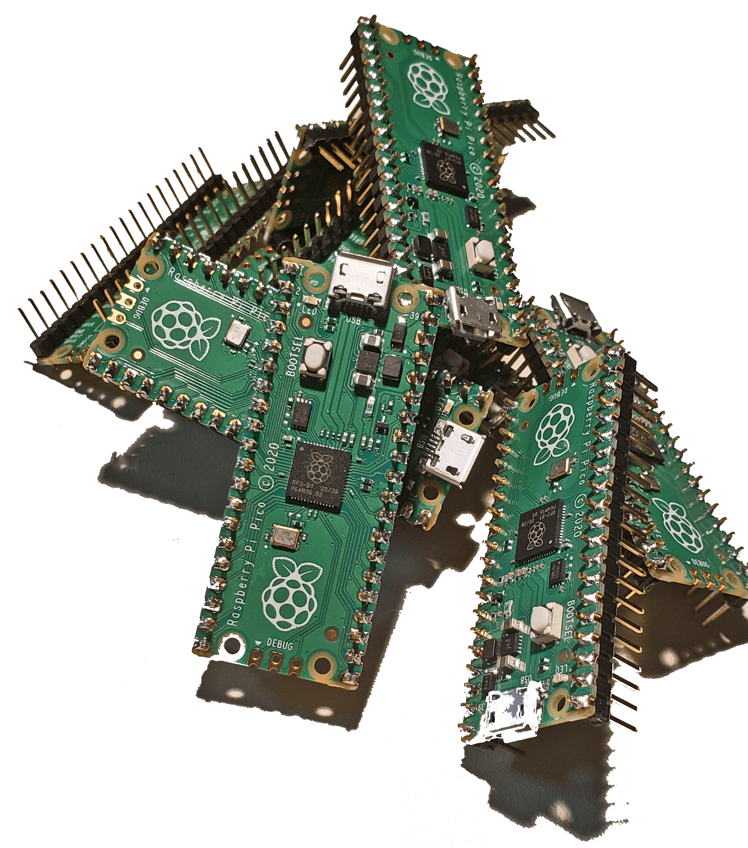
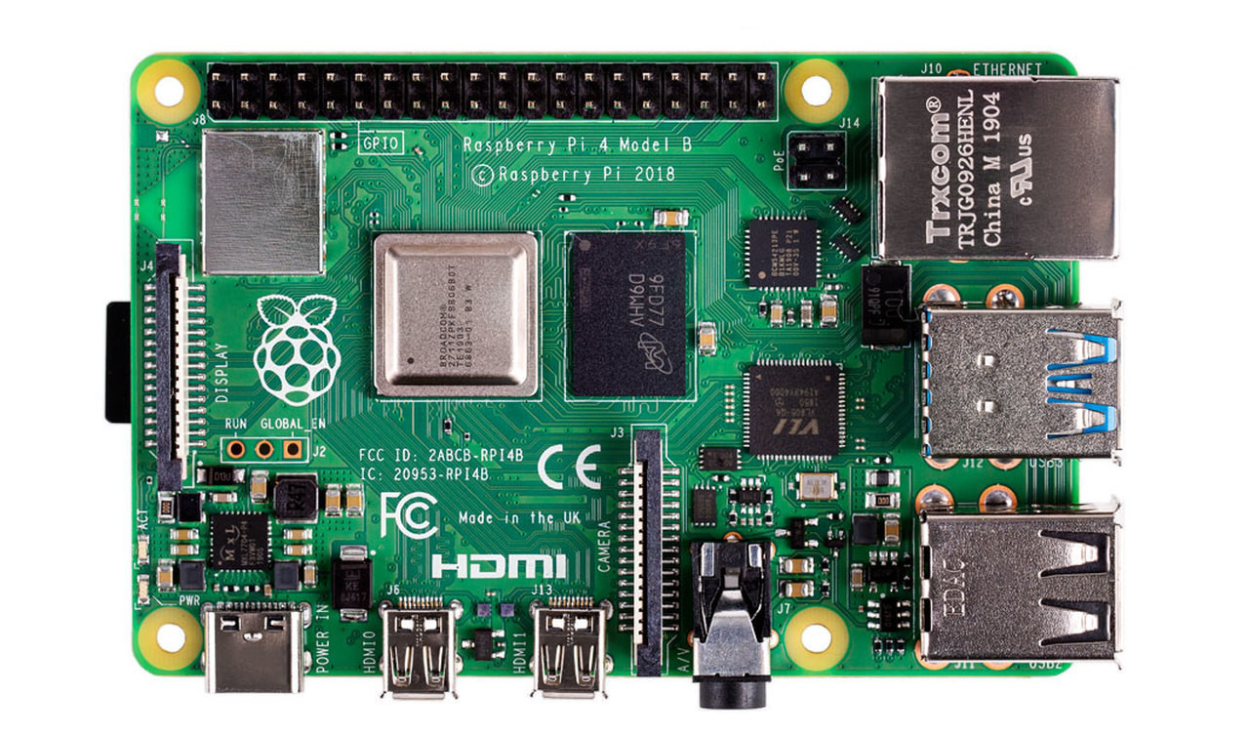
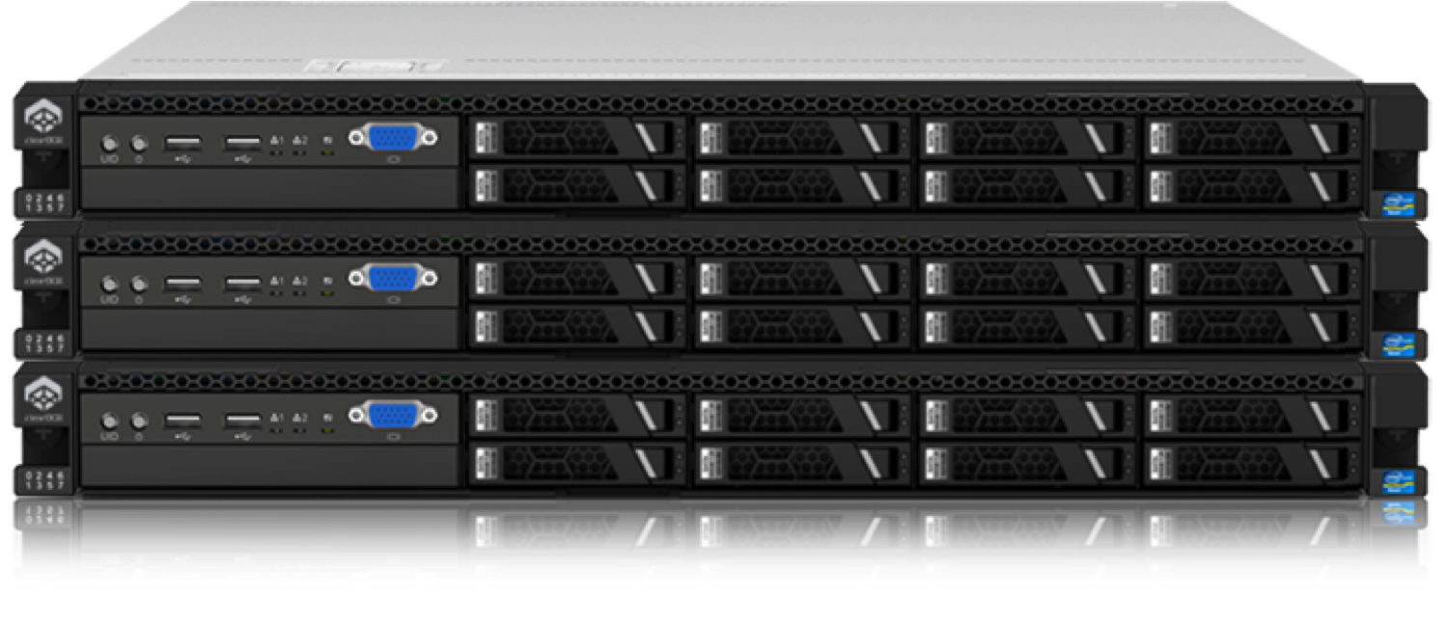
What is Edge-Iot?
This Photo by Unknown Author is licensed under CC BY-NC

Slide 5
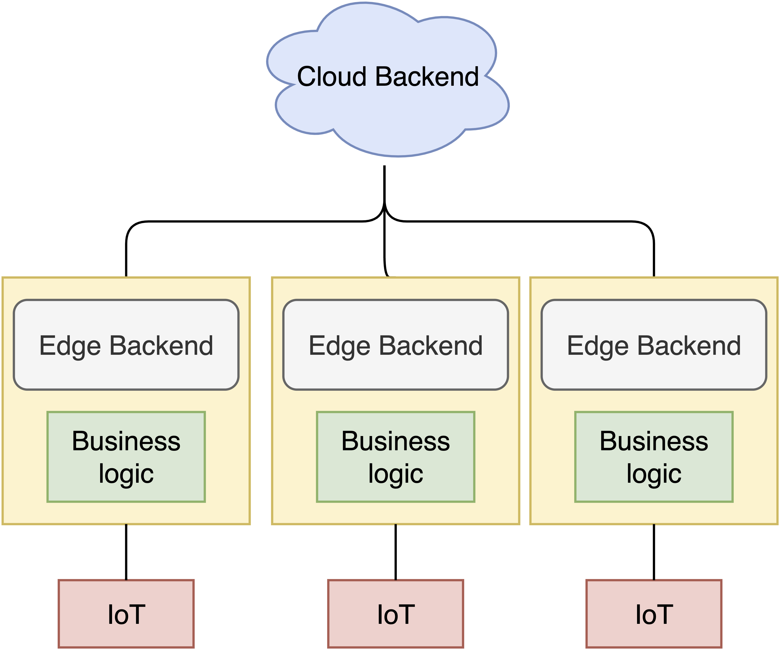
The Basics: A Typical Iot-Edge Deployment

Slide 6
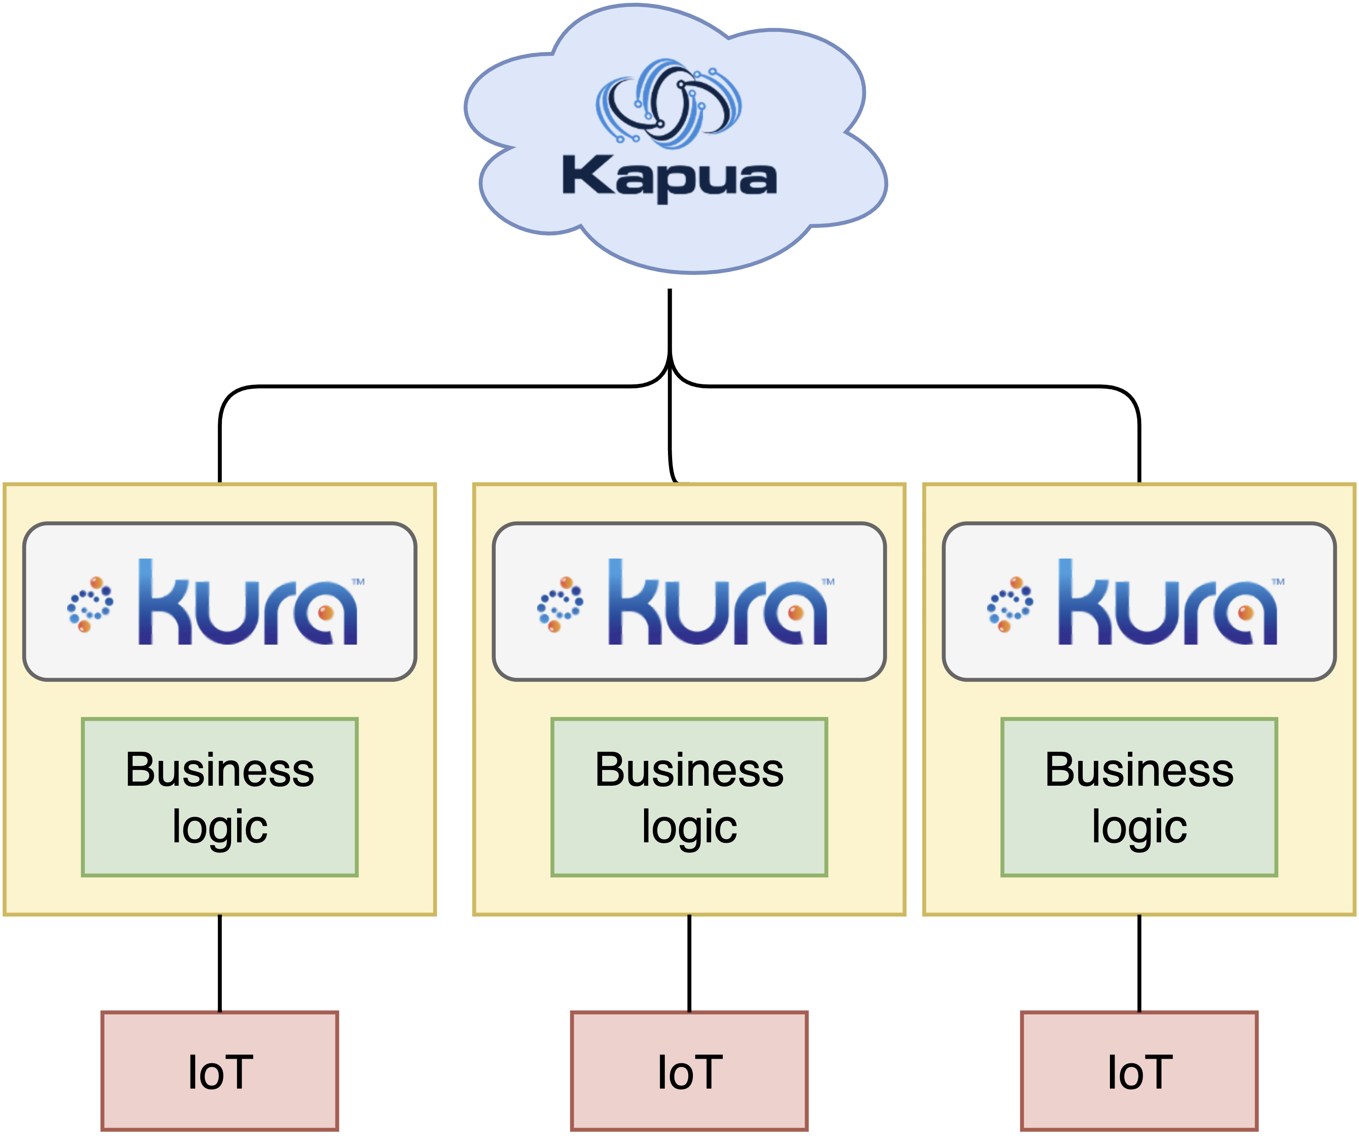
What Eclipse Kura & Eclipse Kapua look like in a deployment

Slide 7

What is
Edge framework that runs on confined devices (i.e. Raspberry Pi)
Kura-Wires allows users to visually program data flows
Orchestrates containers
Sends & Accepts MQTT data streams
Safely stores configurations & secrets
User friendly web accessible UI
Notes:
Eclipse Kura is a software framework that runs on your edge that implements and simplifies the basics needed to get an Edge deployment running. Out of the box, Kura handles communication to Iot devices using various protocols such as MQTT.

Slide 8
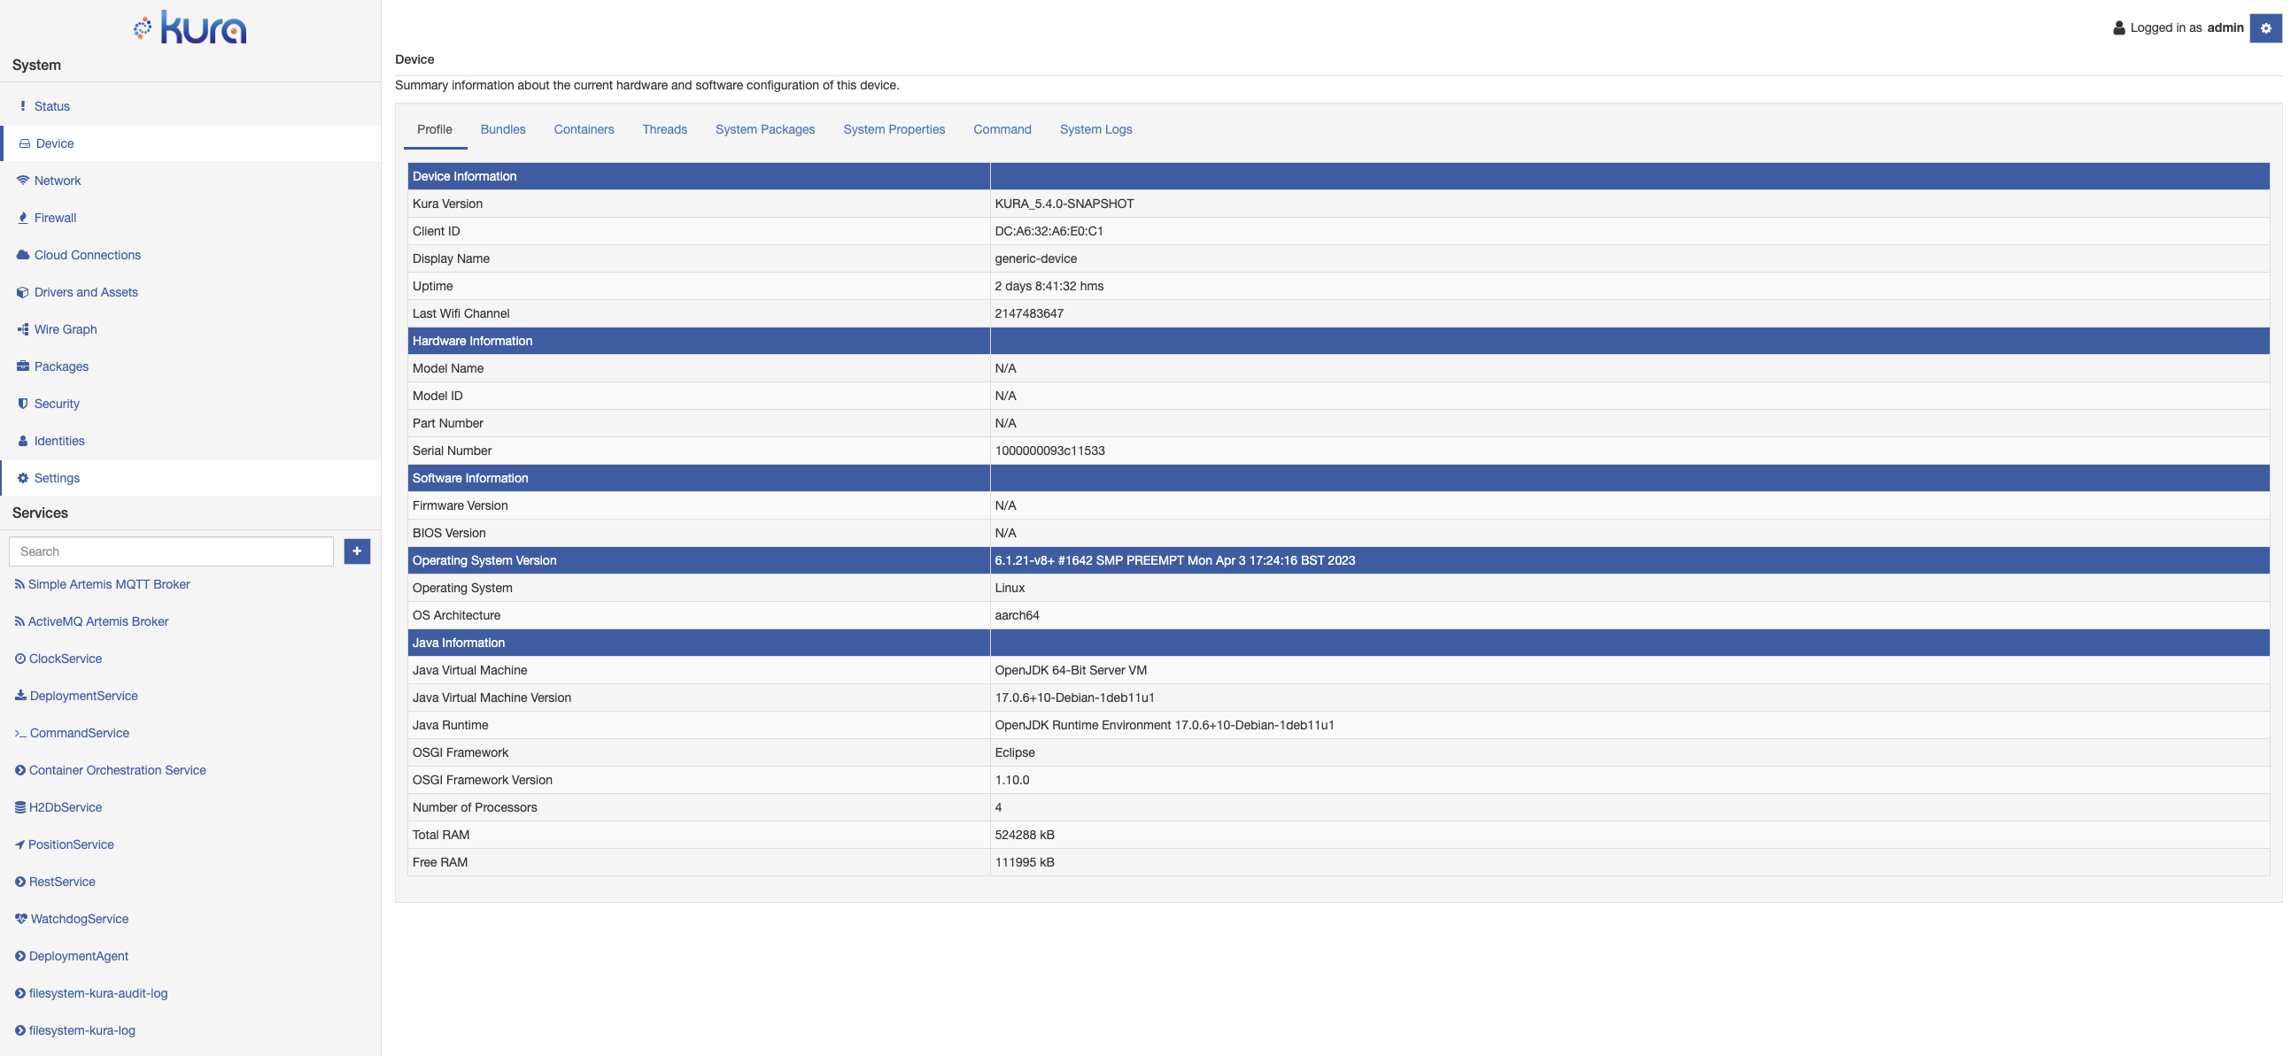

Slide 9
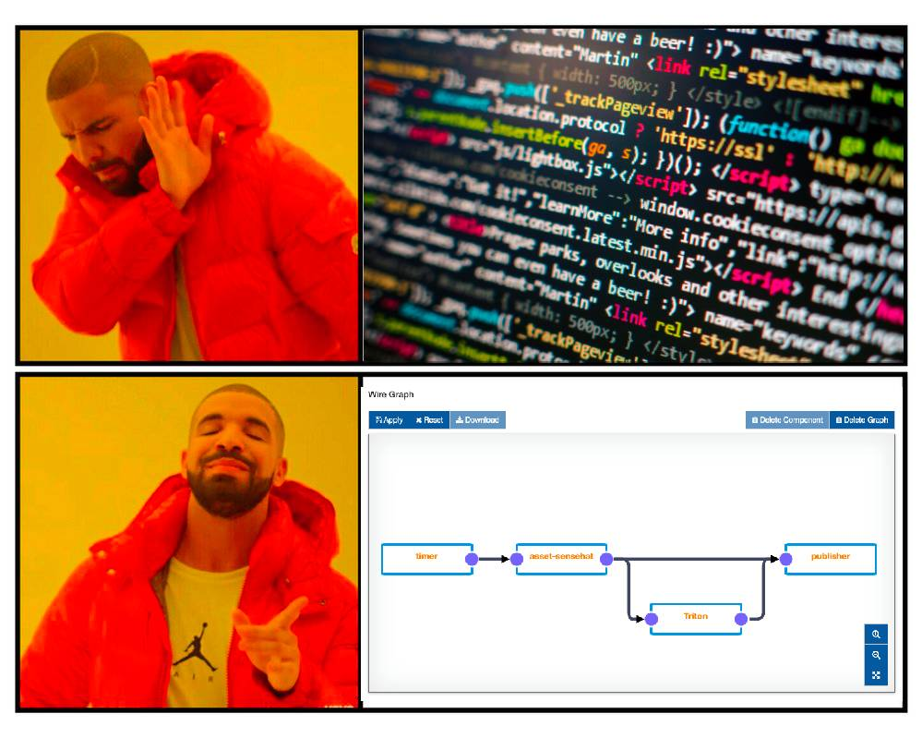
Wire Graph
Data flows and logic, programmed visually
Drag, drop and connect wire-assets to define your business logic
Data flows and logic, programmed visually
Drag, drop and connect wire-assets to define your business logic
Simplify Development
Never forget what your code is doing
Notes:
Wire graph makes it Easier

Slide 10
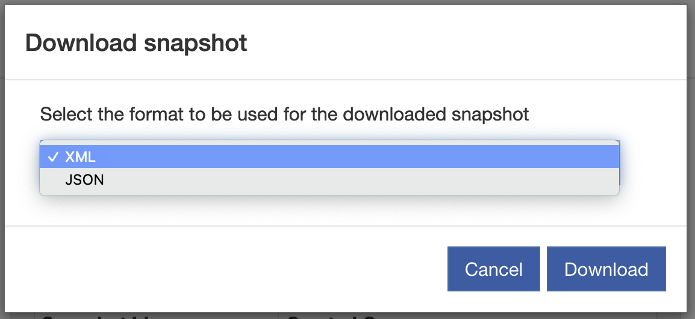
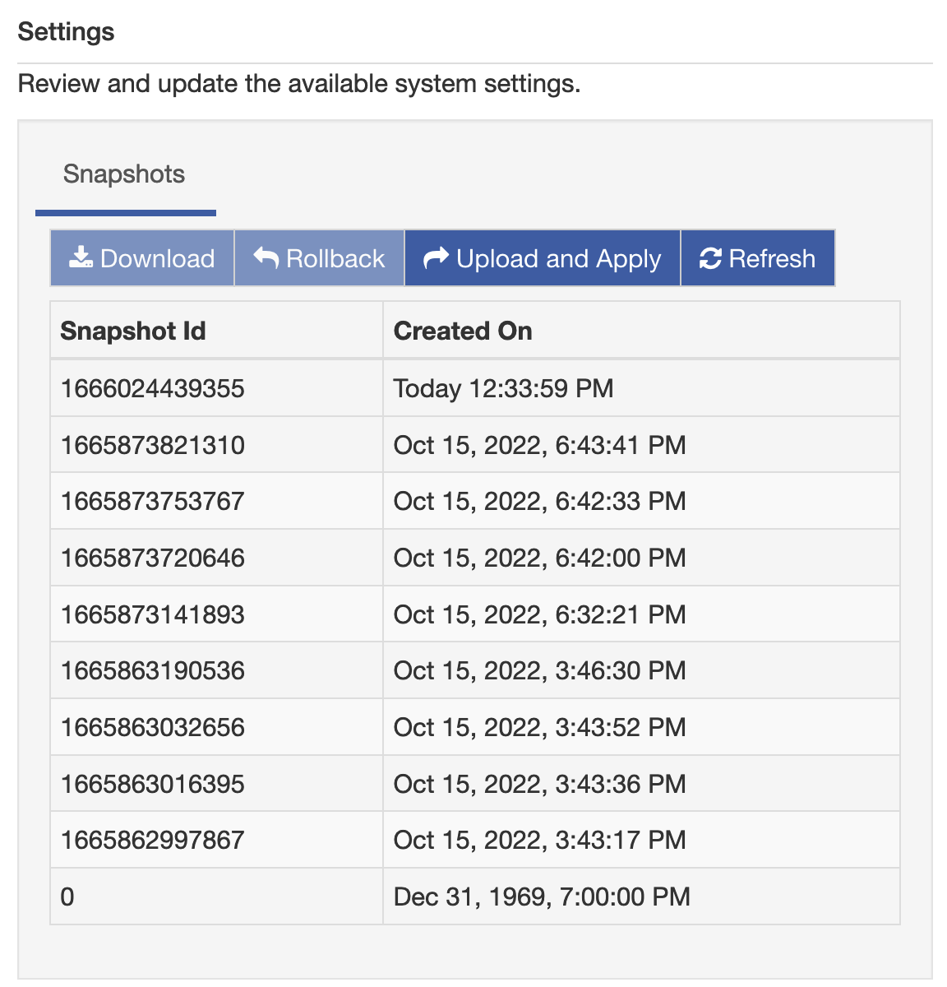
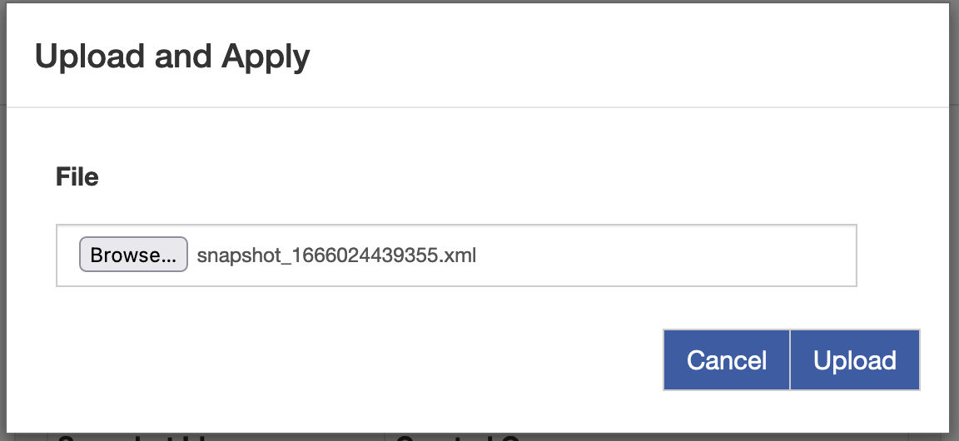
Kura – Snapshots

Slide 11
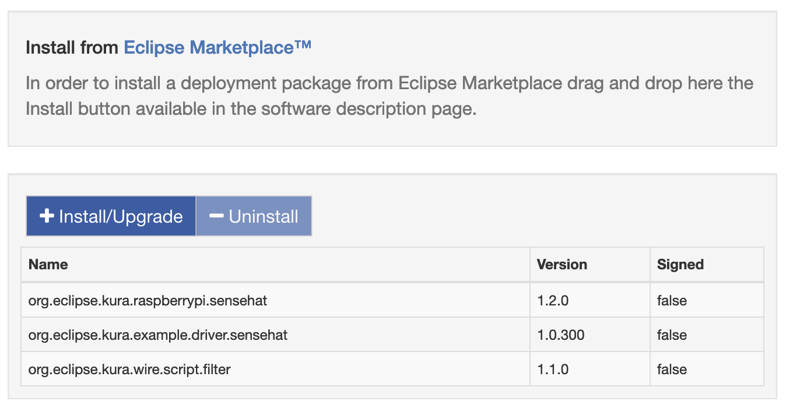
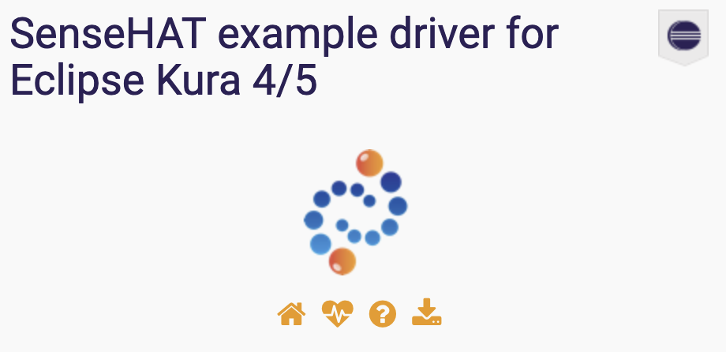
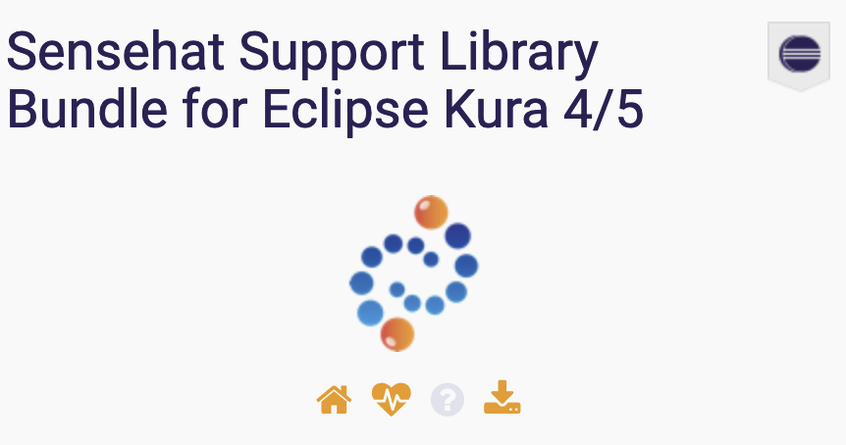


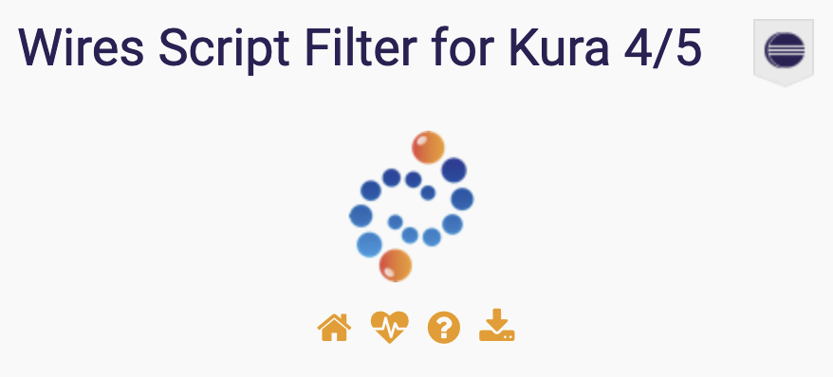
Open Source & Extendible

Slide 12

What is Eclipse Kapua?
Holistic and fully featured Approach to the Edge.
IoT Cloud platform that integrates and manages IoT Gateways
Manages the connectivity of IoT, and Edge gateways
Supports many protocols MQTT, AMQP, and HTTP
Sophisticated multi-tenant account management
Easy data pipelines for collecting mass amounts of information from connected devices
RESTful API for integration with custom applications
intuitive web UI

Slide 13
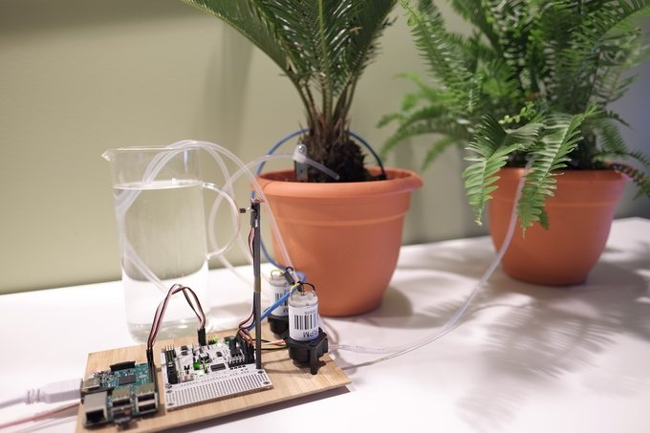
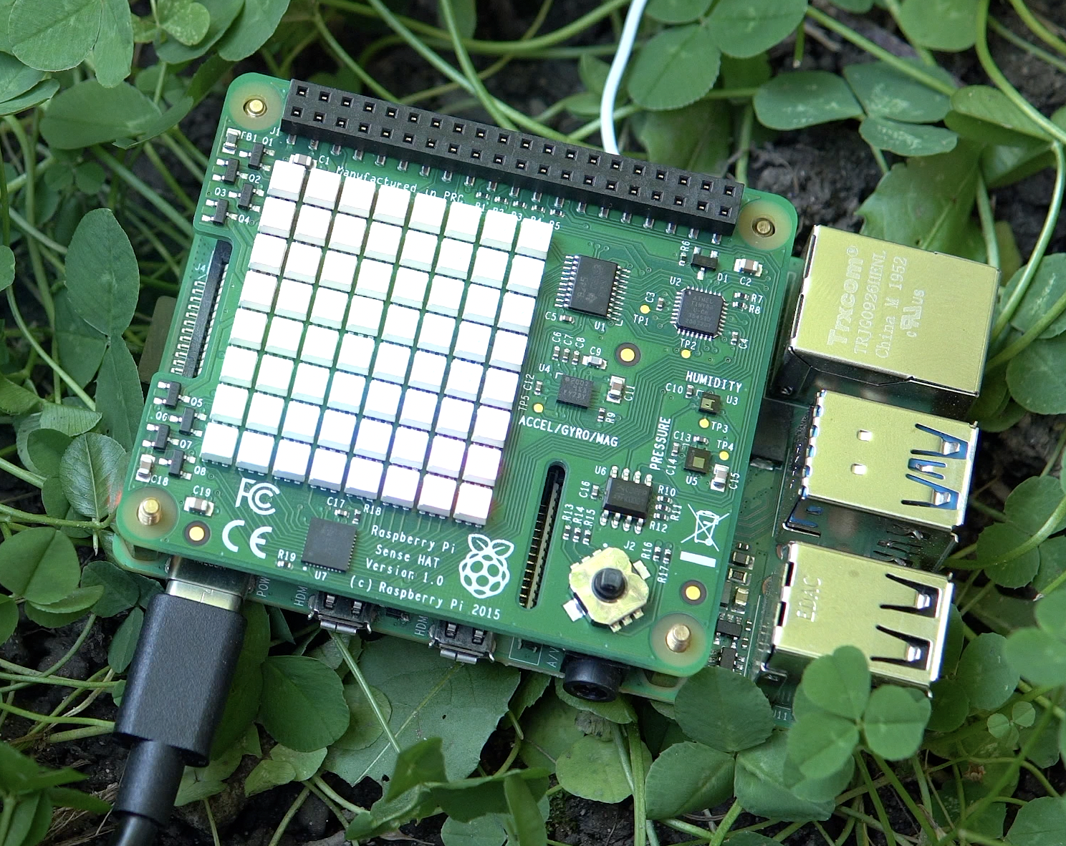
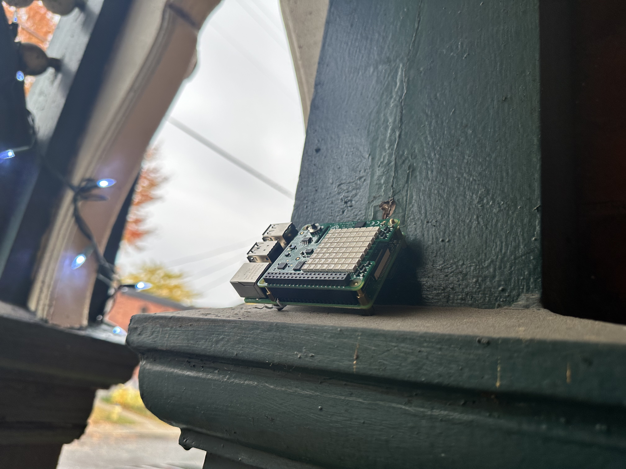
Kapua – Device Connections
Brokered via MQTT
Does not require ports to be opened on the Edge device
Edge devices are expected to not have the best network quality
This Photo by Unknown Author is licensed under CC BY-SA

Slide 14
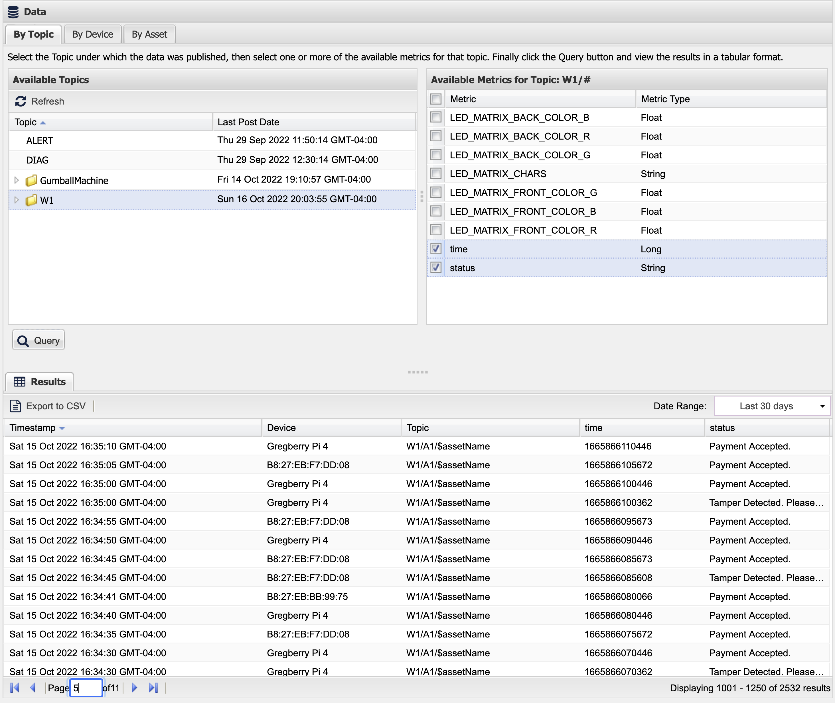
Kapua – Data Aggregation
Data from all of your devices in one place

Slide 15
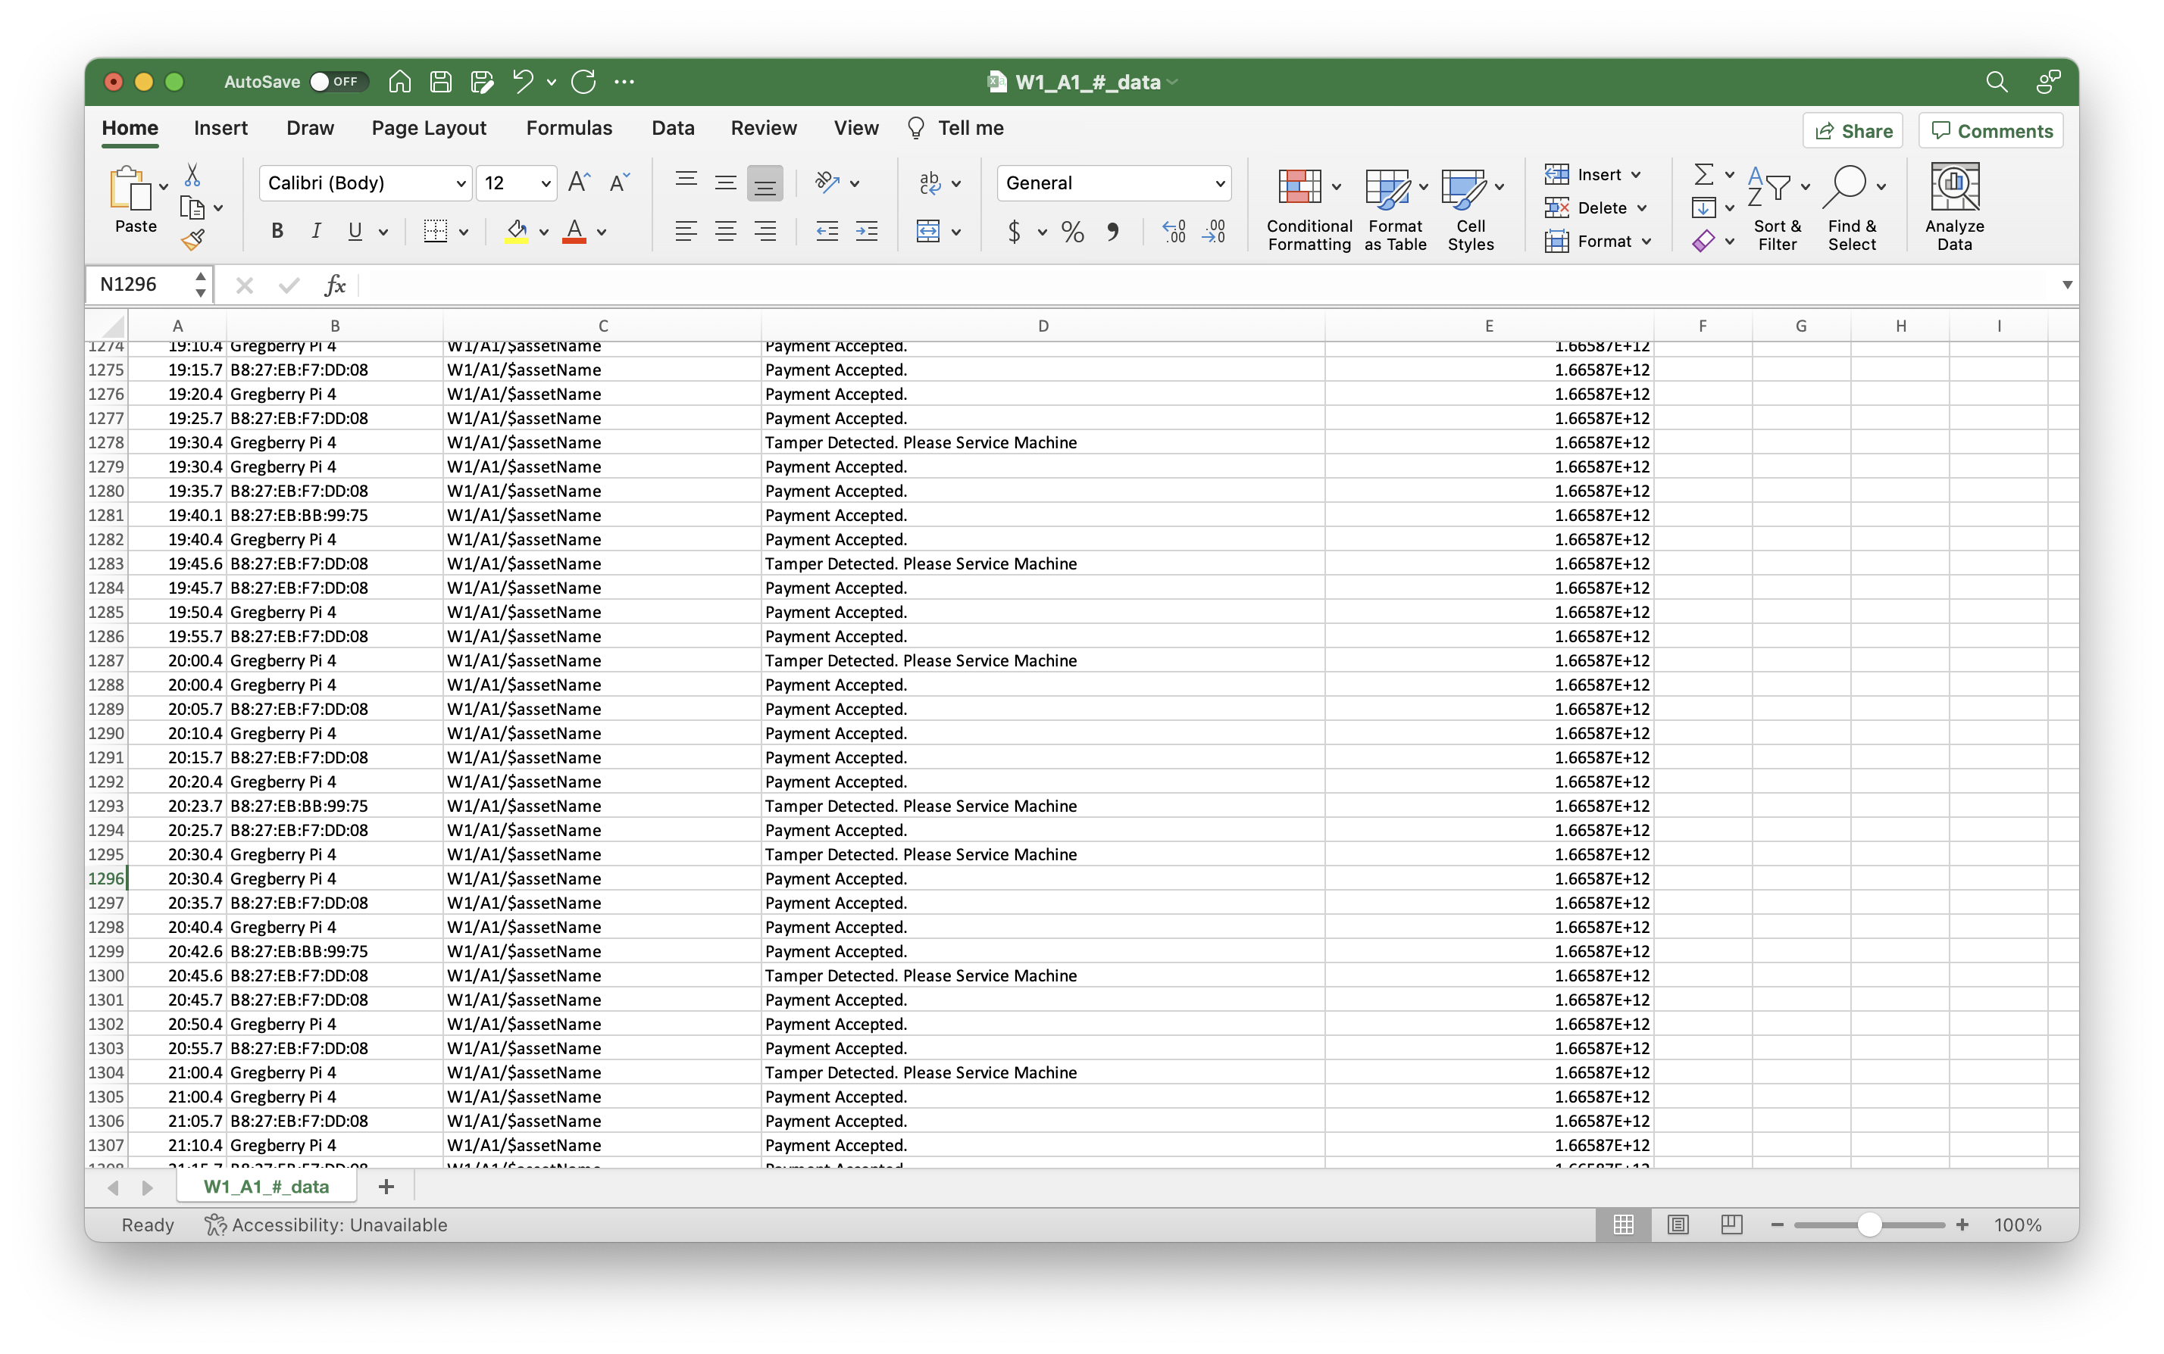
+ REST API’s are Available for data export

Slide 16
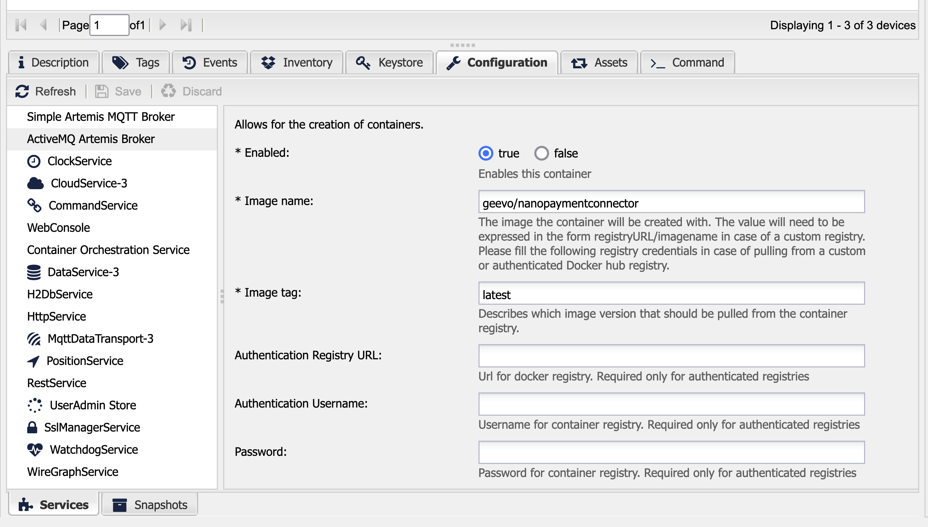
Kapua – Configuration Service
Configure Kura settings from the cloud

Slide 17
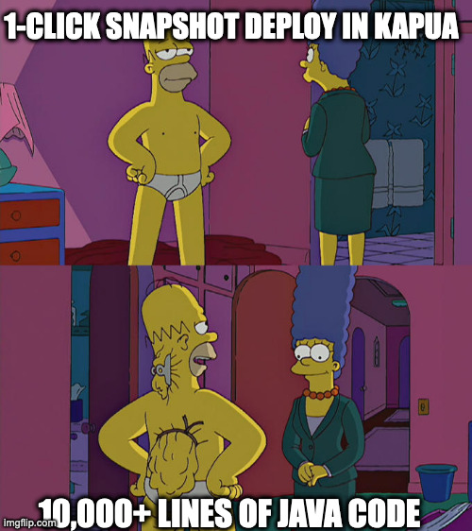
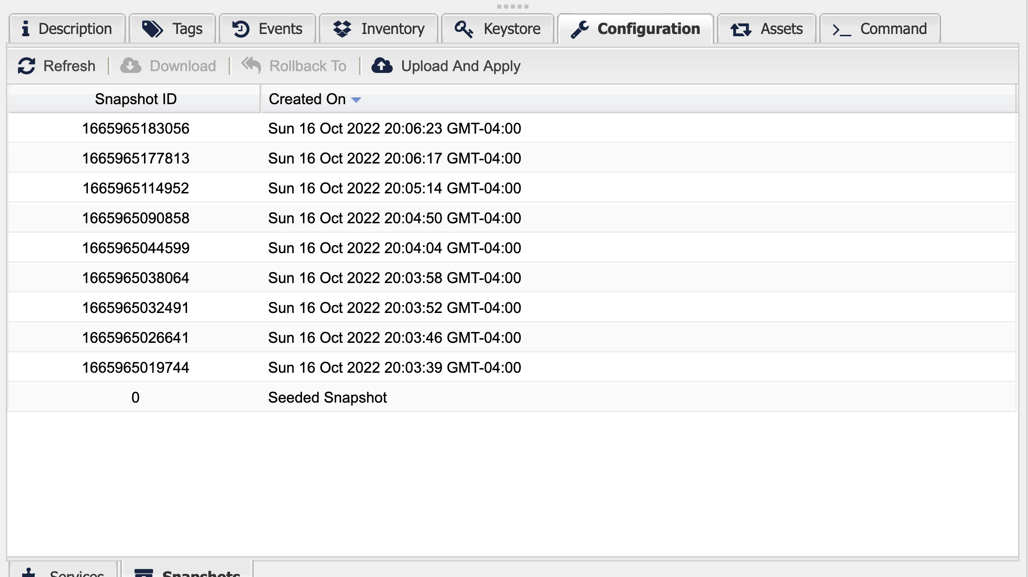
Kapua – Snapshot Service
Scale your deployment by applying snapshots to devices

Slide 18
What Kura & Kapua look like in a deployment

Slide 19
The Future of Edge

Slide 20

Edge Gateways are Getting Powerful
Low Power High Performance CPUs
GPUs
AI acceleration in silicon
HPC’s on the edge …What can you do with this Power?

Slide 21
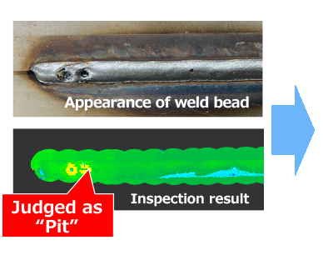
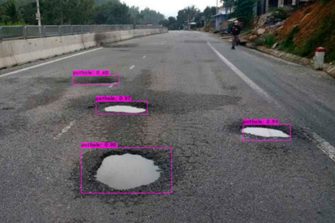
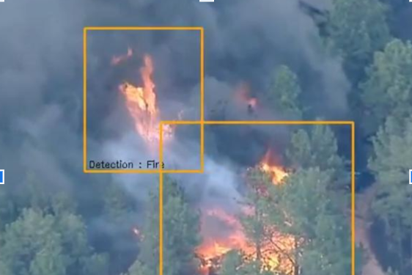
Run AI Workloads on the Edge
Faster response times
Reduce bandwidth
Do the unimaginable with typical cloud-Iot Infrastructure on scale

Slide 22
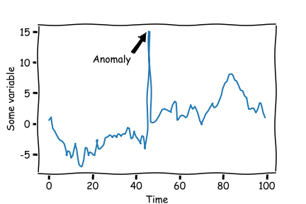
Anomaly Detection
Identifying points of data which fall outside the expected range
Applications
Industry – Part Quality
Business – Fraud detection
Cyber Security – Intrusion Detection
Health Monitoring – ECG Irregularities
[1]
[1] https://github.com/DHI/tsod

Slide 23
Goals
Collect Data using Simulated Edge
Use collected data to Train an Anomaly Detection Model
System Monitoring
Deploy your model to your edge, and Detect Anomalies in the Field

Slide 24
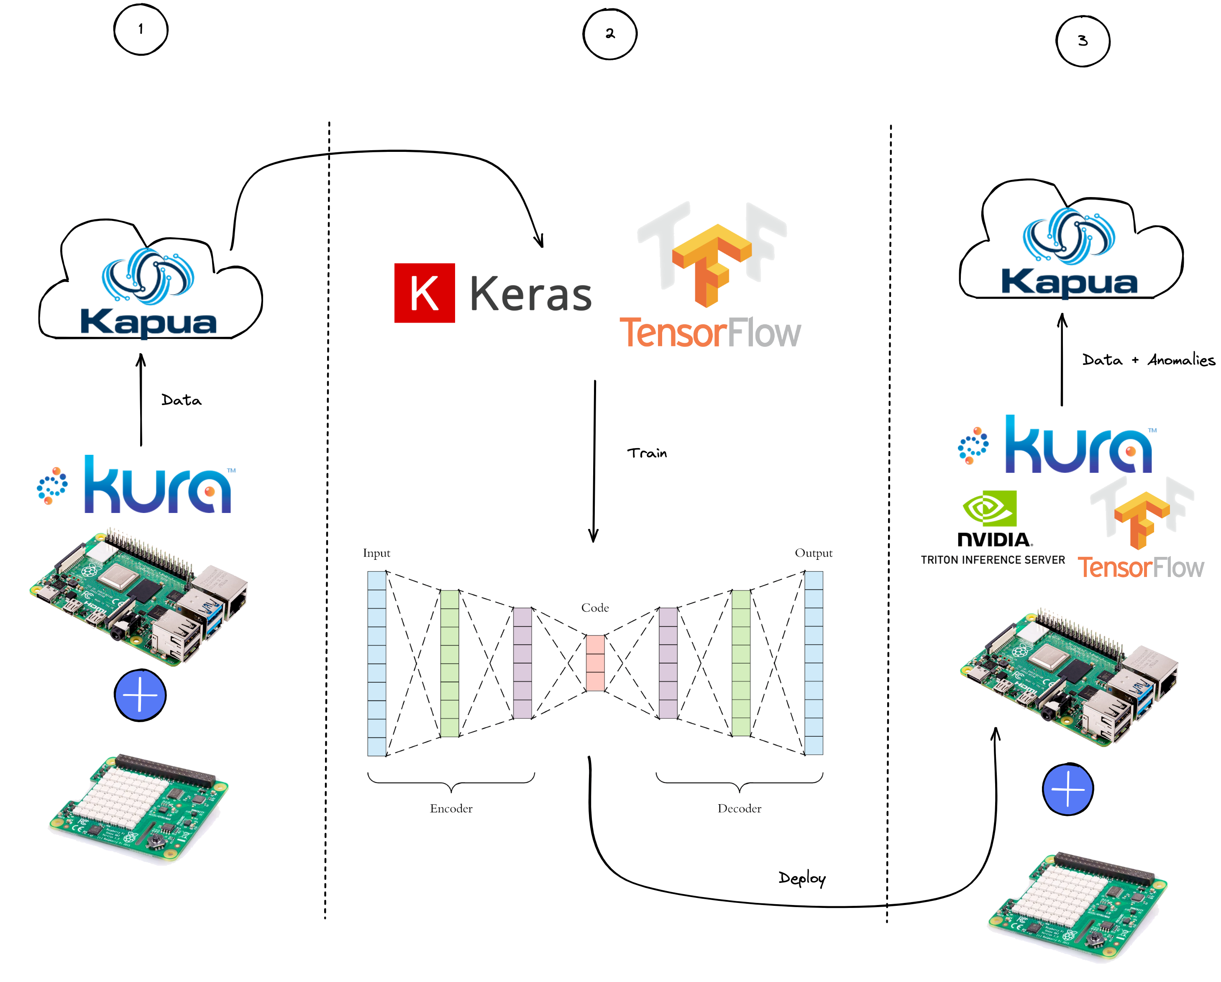
The Game Plan
Setup Kura
Connect Kura to Kapua
Data Collection
AI model building and training
Deploy your AI model on the edge

Slide 25
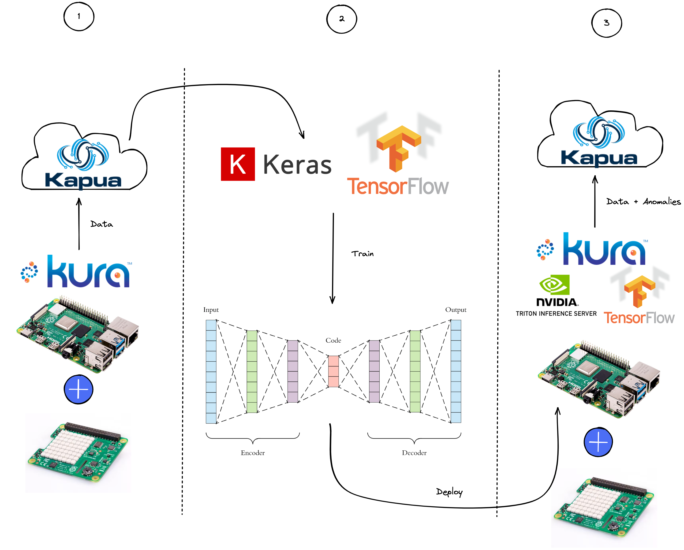

The Game Plan

Slide 26
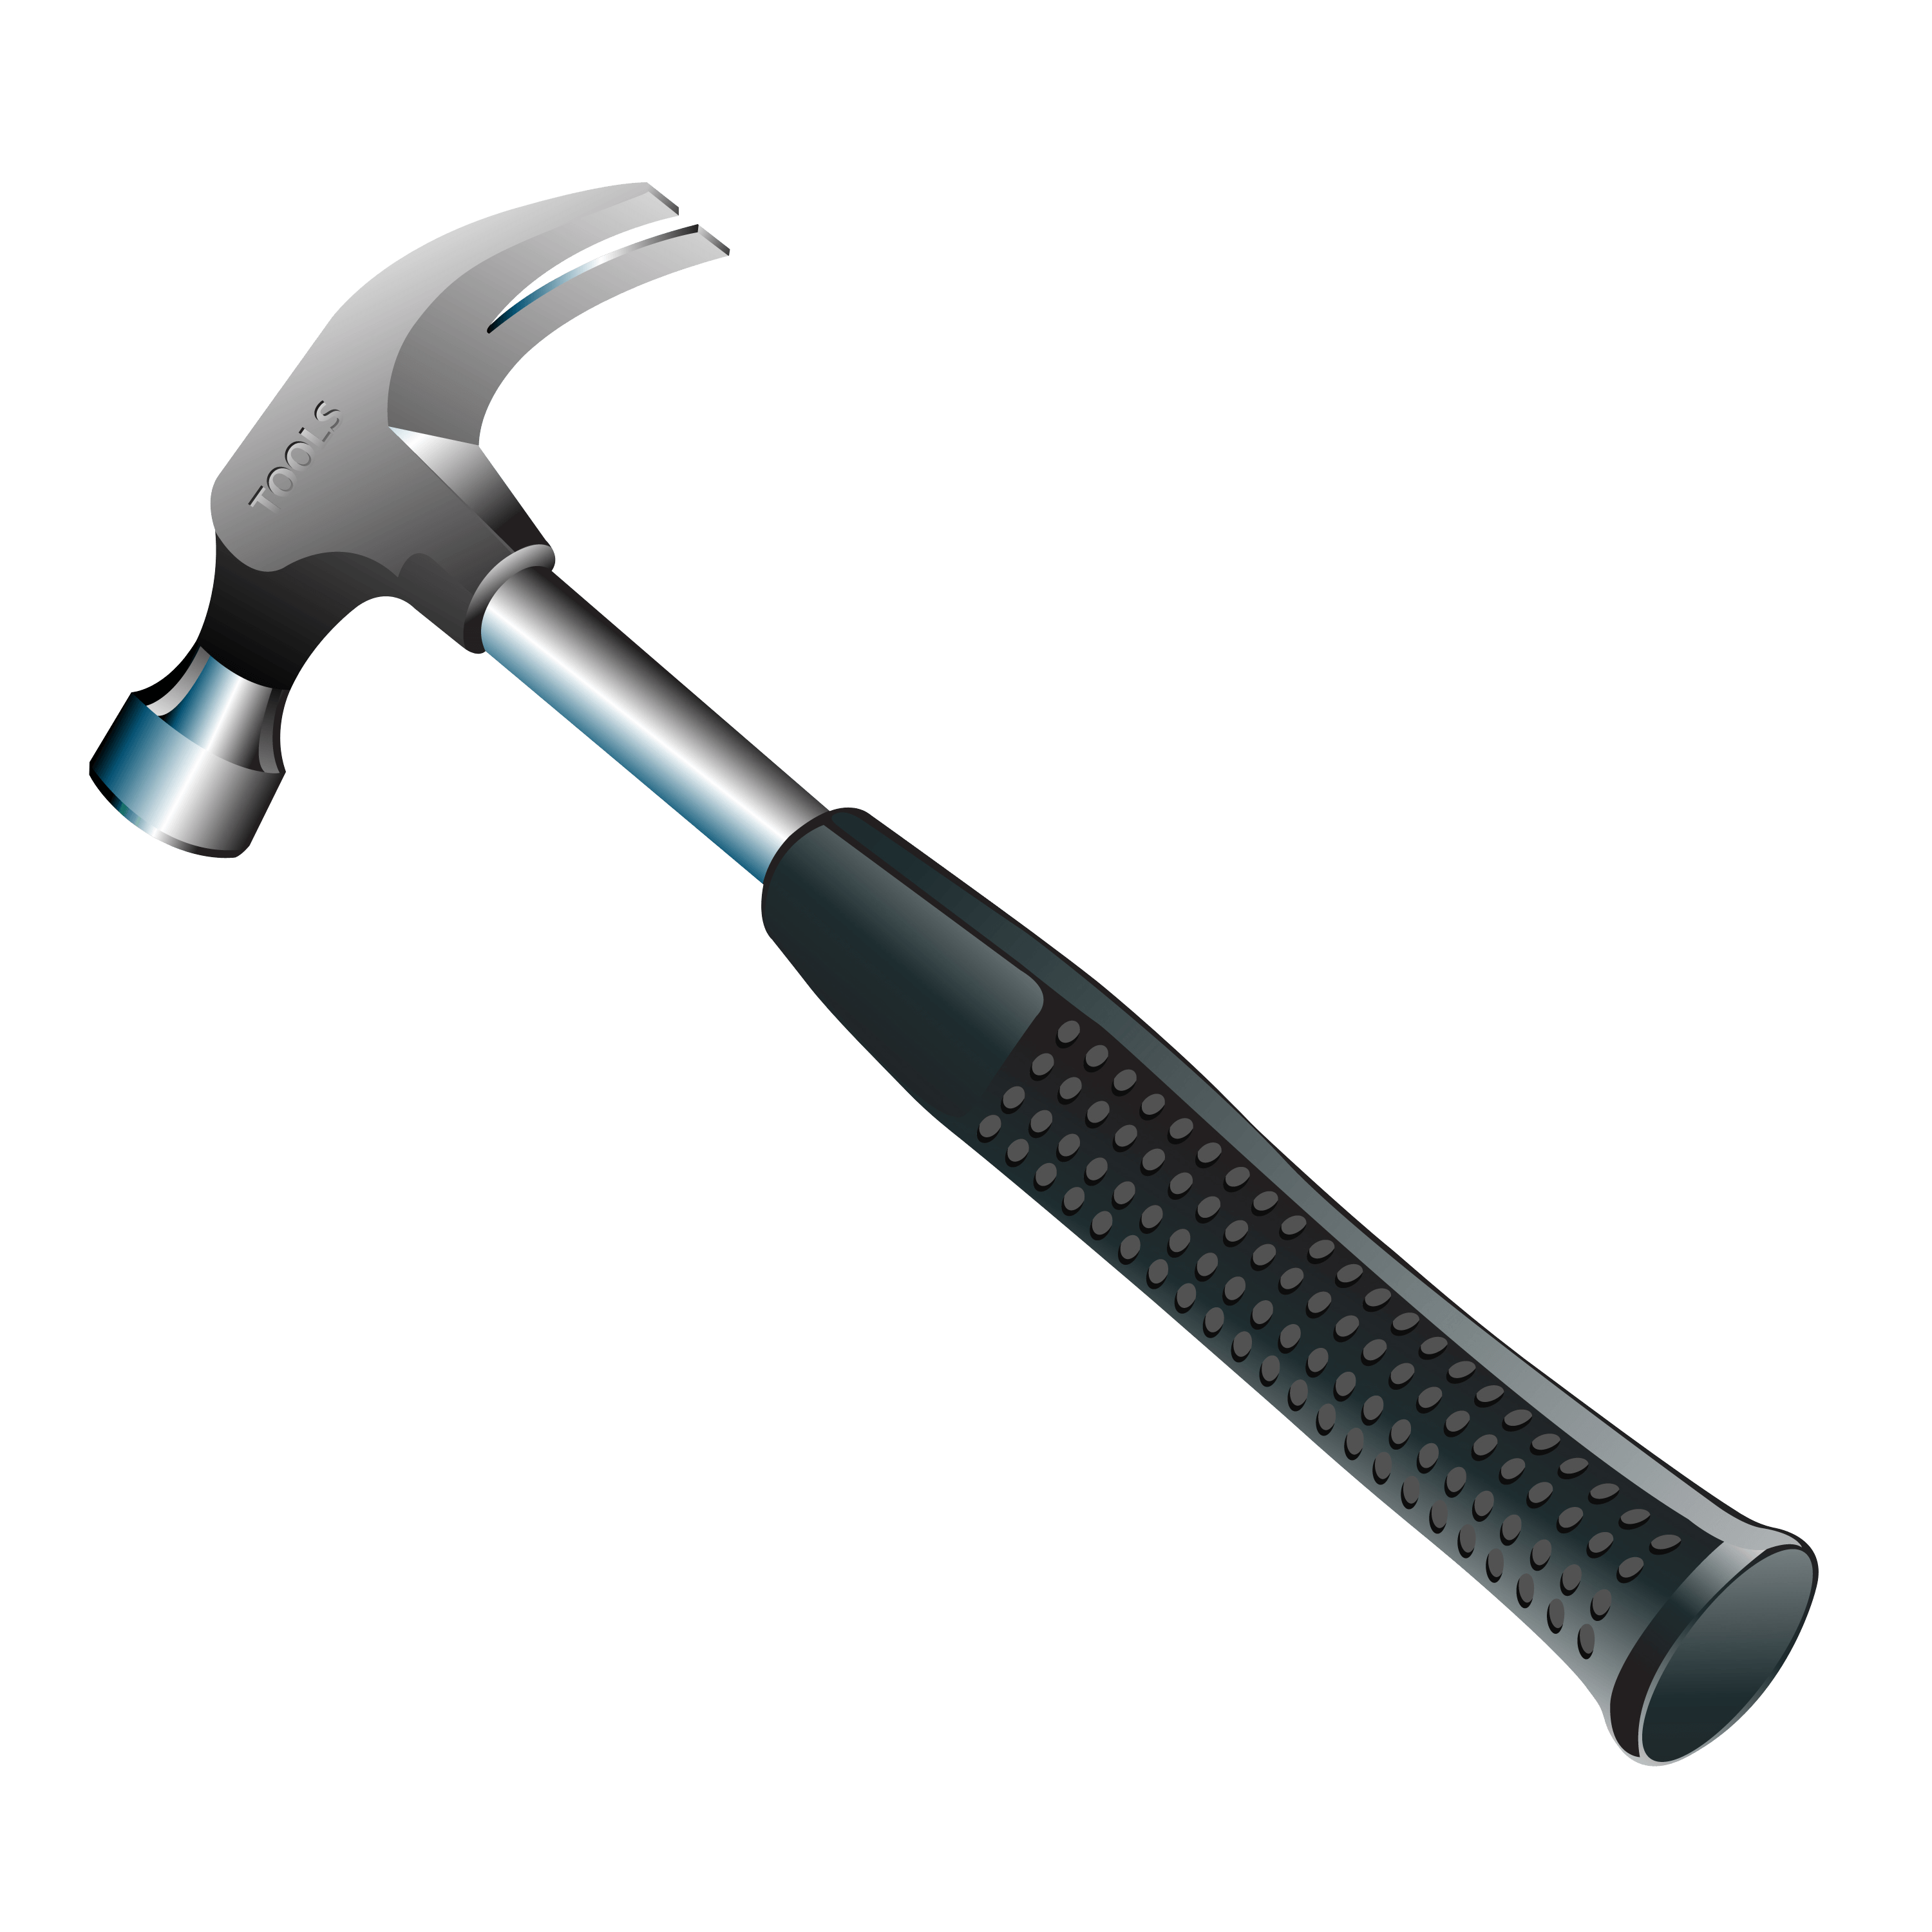
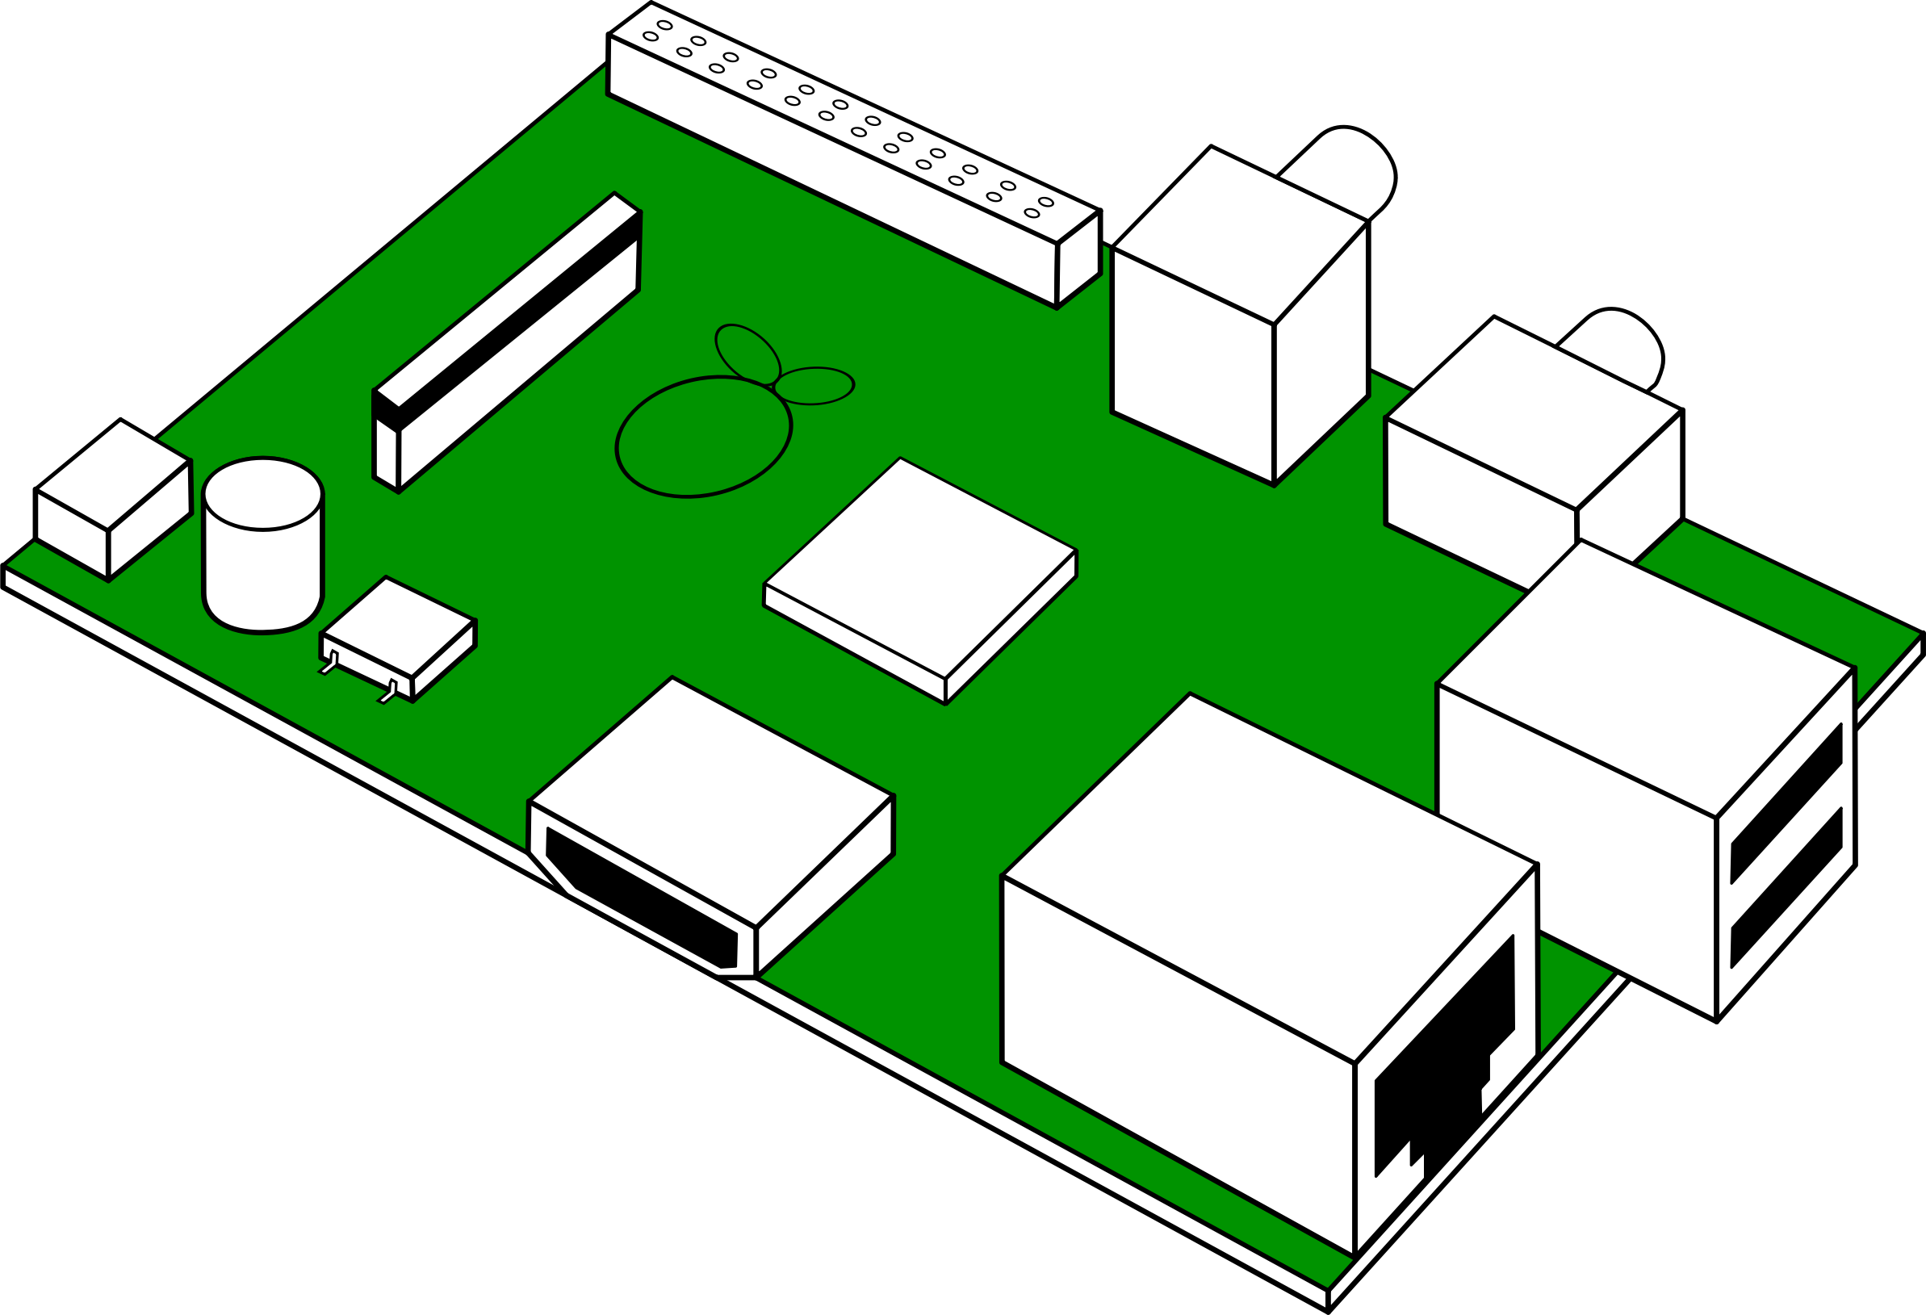
Todays Demo
Setup Kura
Connect Kura to Kapua
Data Collection
AI model building and training
Deploy your AI model on the edge
This Photo by Unknown Author is licensed under CC BY-NC

Slide 27

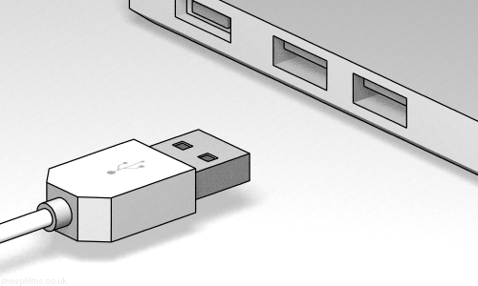
How to get started with today’s tutorial
Download the demo via the following URL
Plug in the provided USB stick
OR
https://qrco.de/beQ6TT
Then, Follow the instructions in Setup.md file

Slide 28
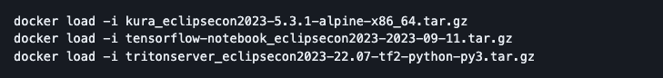
Setup Kura
Load the three archives containing the docker containers required for this tutorial with the following commands:
Run the following command to start:
Verify the containers are running:

Slide 29
Setup Kura - cont
Eclipse Kura™: https://localhost
Credentials: admin/admin
Jupyter Nokebook: http://localhost:8888/lab?token=`token-id`
Credentials: the token-id noted earlier
Nvidia™ Triton: localhost:4000-4002 (no web fronted)
Eclipse Kapua™: https://eclipsecon2023-kapua.dev.everyware.io
Account: eclipsecon2023
Credentials: Check on card you received
MQTT port: 1883

Slide 30
Questions?
30

Slide 31
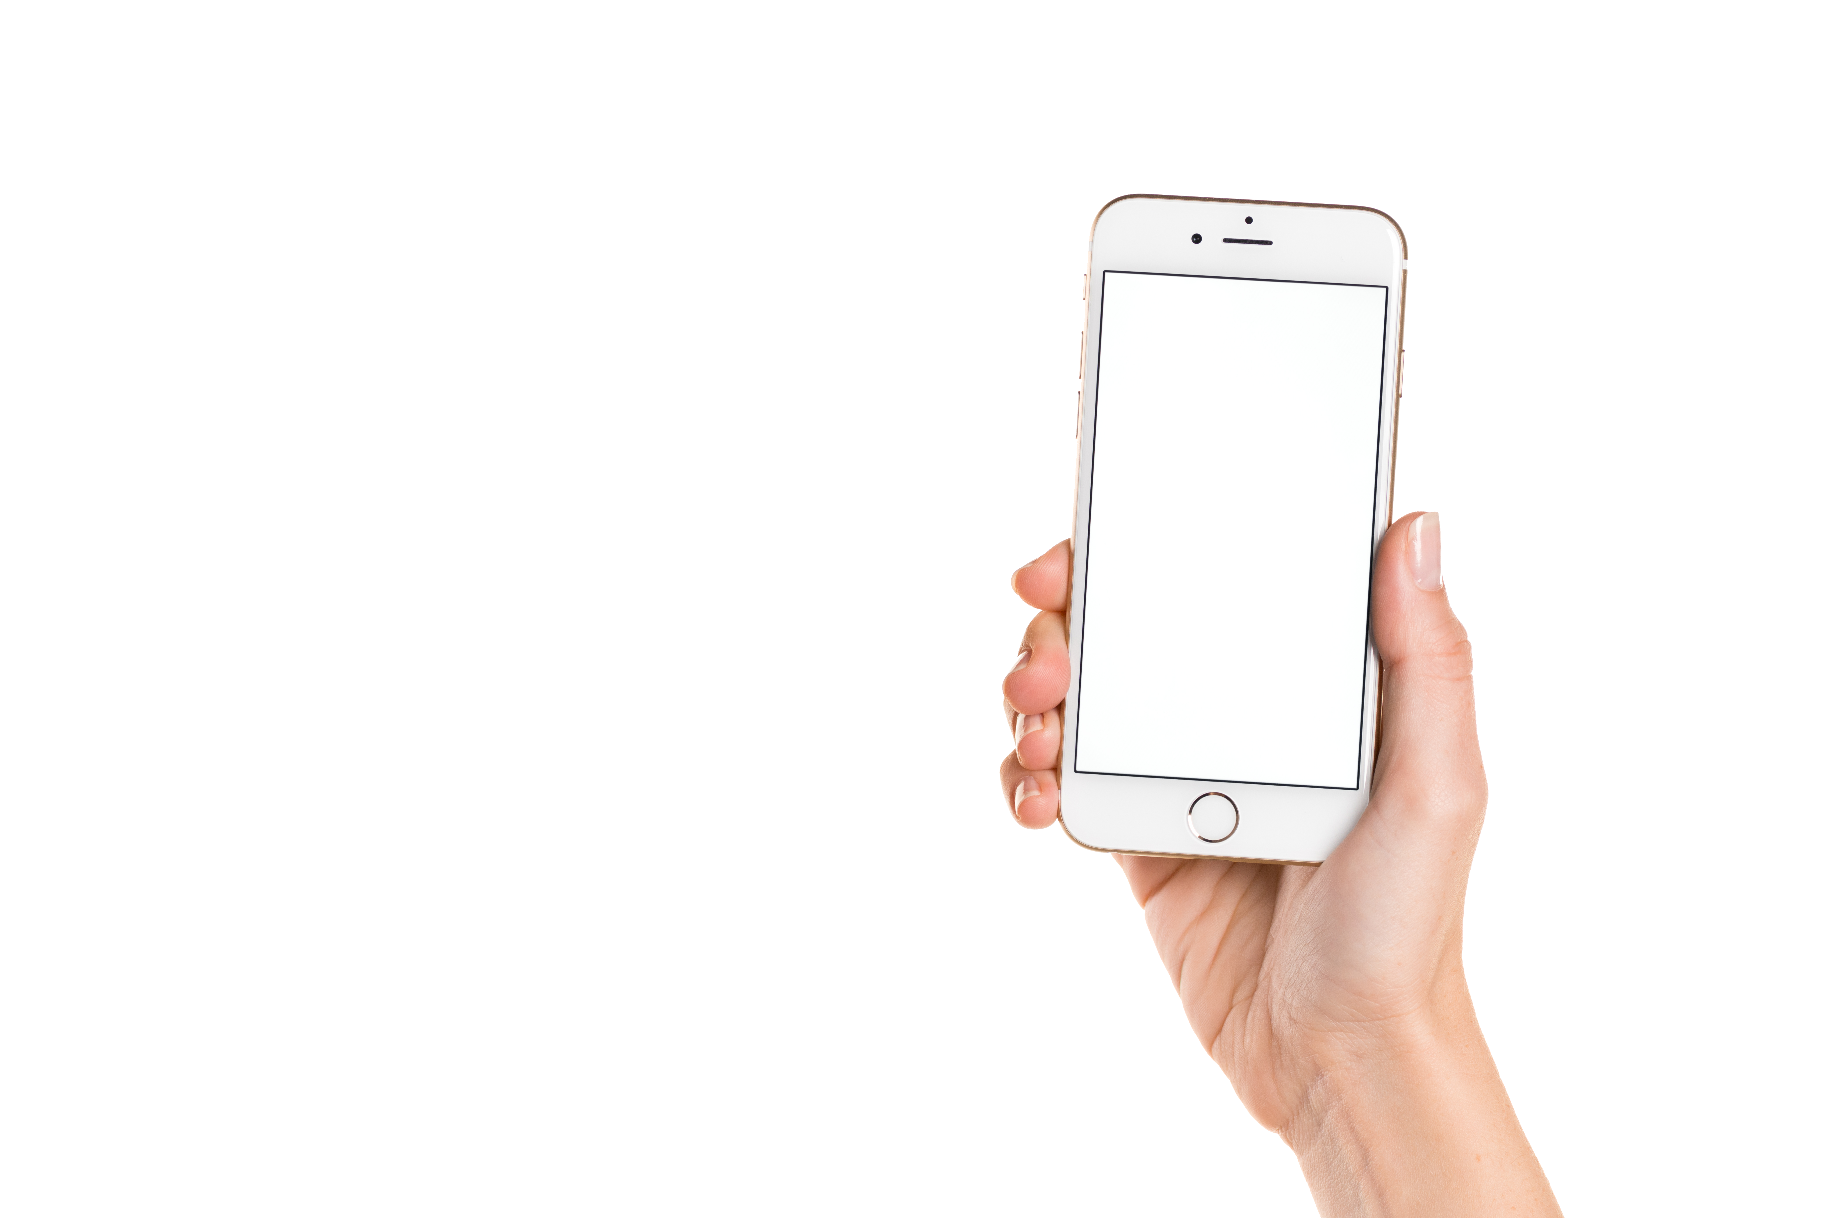

scan qr code
get your gadget* at Eurotech booth #06
fill out our form
* limited supply

Slide 32


Thank you!
Join the conversation:
@EclipseCon | #EclipseCon

Slide 33


Check us out on GitHub

Slide 34
Evaluate the Sessions
Please help by leaving feedback on the sessions you attend!
To rate a session, you must be registered for it in Swapcard BEFORE the talk starts.
Swapcard will prompt you to leave feedback after the end of each session.
You may also rate a talk by locating the session from the “Agenda” or “My Event” buttons on the Swapcard Event Home page. Click on the session and look for the “Give your feedback” box.

